Slide 1
Recording in session
Notes:
Press the Record button.
This virtual session is being recorded.

Slide 2
DATA ANALYSIS / DISTRICT areas of NEED
2024-2027 Three-Year LCAP Development
LCAP | Educational Partner Engagement | February 9, 2024

Slide 3
Recording in session
Notes:
Press the Record button.
This virtual session is being recorded.

Slide 4
Welcome
Welcome / Opening
Superintendent Dr. Michelle Rodriguez
English: https://www.stocktonusd.net/cms/lib/CA01902791/Centricity/Domain/142/SUSD%20State%20of%20the%20District%202023%20-%20English.pdf
Spanish:
https://www.stocktonusd.net/cms/lib/CA01902791/Centricity/Domain/142/SUSD%20State%20of%20the%20District%202023%20-%20Spanish.pdf
“ALL OF SUSD”
Dashboard
www.allofsusd.net
https://www.stocktonusd.net/Page/17757

Slide 5
LCAP Team Update
Superintendent
Assistant Superintendent, Student Support Services
Program Technician
Family Engagement Specialist
Interim Chief Business Official
Budget Analyst
Director of LCAP and State & Federal
Director of Research & Accountability
Research Analyst
We Support…
District Departments
District School Sites
Dependent Charters
Charters (Authorized By SUSD)

Slide 6
AGENDA
Data Analysis / District Areas of Need
Topics:
LCAP Engagement In 2023-2024
LCAP and SUSD Guiding Principles
Prior Engagement Session Recap
Opportunities to Build Trust Through Authentic Engagement
Data Analysis
District Areas of Need
Next LCAP Engagement Session

Slide 7
LCAP Engagement in 2023-2024
11/28: Introduction: LCAP Fundamentals
12/04: Current District Priorities – 2023-2024 School Year
01/19: LCAP Mid-Year Update and Funding
02/09: Data Analysis / District Areas of Need
02/16: Budget Projections
03/05: Survey Results and Key Findings
03/08: Identified District Goals/Activities
* April 2024: Post Draft 2024-2027 LCAP
* May 2024: Public Hearing 2024-2027 LCAP
* June 2024: Board Adoption 2024-2027 LCAP

Slide 8
LCAP and SUSD Guiding principles
IMPROVING
STUDENT
OUTCOMES

Slide 9
Think time
Question:
SUSD Kindness Challenge Week
What acts of kindness and care have you witnessed that reinforce “Joy, Trust, and Belief” within our district and/or wider community?
2 minutes to post your comment(s) in the chat box or report out.

Slide 10
Prior engagement session recap
CIRCLING
BACK

Slide 11
Prior engagement session topics
Topics Presented:
LCAP Requirements and Components
LCAP Development
LCAP Lifecycle
LCAP Requirements
Educational Partners
LCAP Approval Process
Local Control Funding Formula
LCAP and School Plan for Student Achievement (SPSA) Alignment
Connecting 2023-2024 District Priorities
Mid-Year Update and Funding Overview
Missed the Session?
SUSD recorded the Zoom LCAP Engagement Session for post meeting review at your convenience.
These recordings and the presentations are available on the district’s LCAP webpage: https://www.stocktonusd.net/Page/16289
The district’s current (and past) LCAP is available too.

Slide 12
Opportunities to build trust Through Authentic Engagement
YOUR
VOICE
MATTERS!

Slide 13
DATA ANALYSIS / district areas of need

Slide 14
Data Analysis process steps
What do YOU want to prove?
What do YOU want to disprove?
What do YOU want to know?

Slide 15
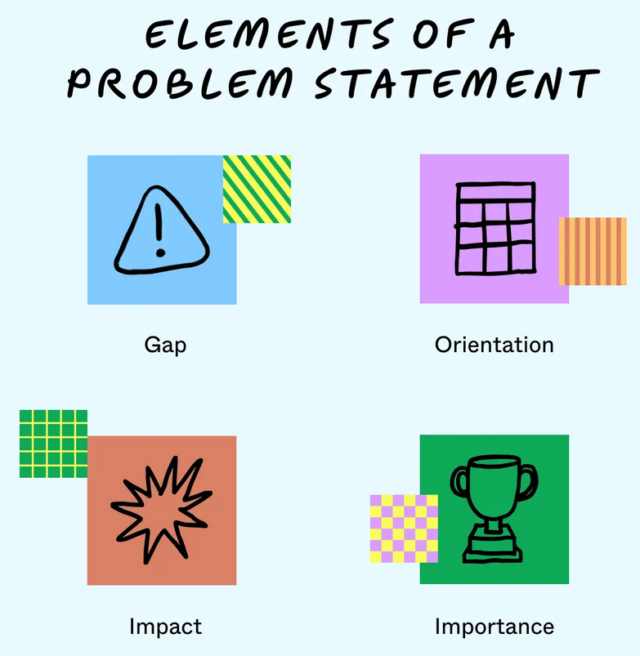
1. Define the question aka problem statement
Gap: Challenge…Issue…
Orientation: Background – When? Where? Who?
Impact: Consequences…
Importance: Why does it matter?
Notes:
What is the topic or problem?
What do you want to know?
What are you wanting to prove?
What are you wanting to disprove?

Slide 16
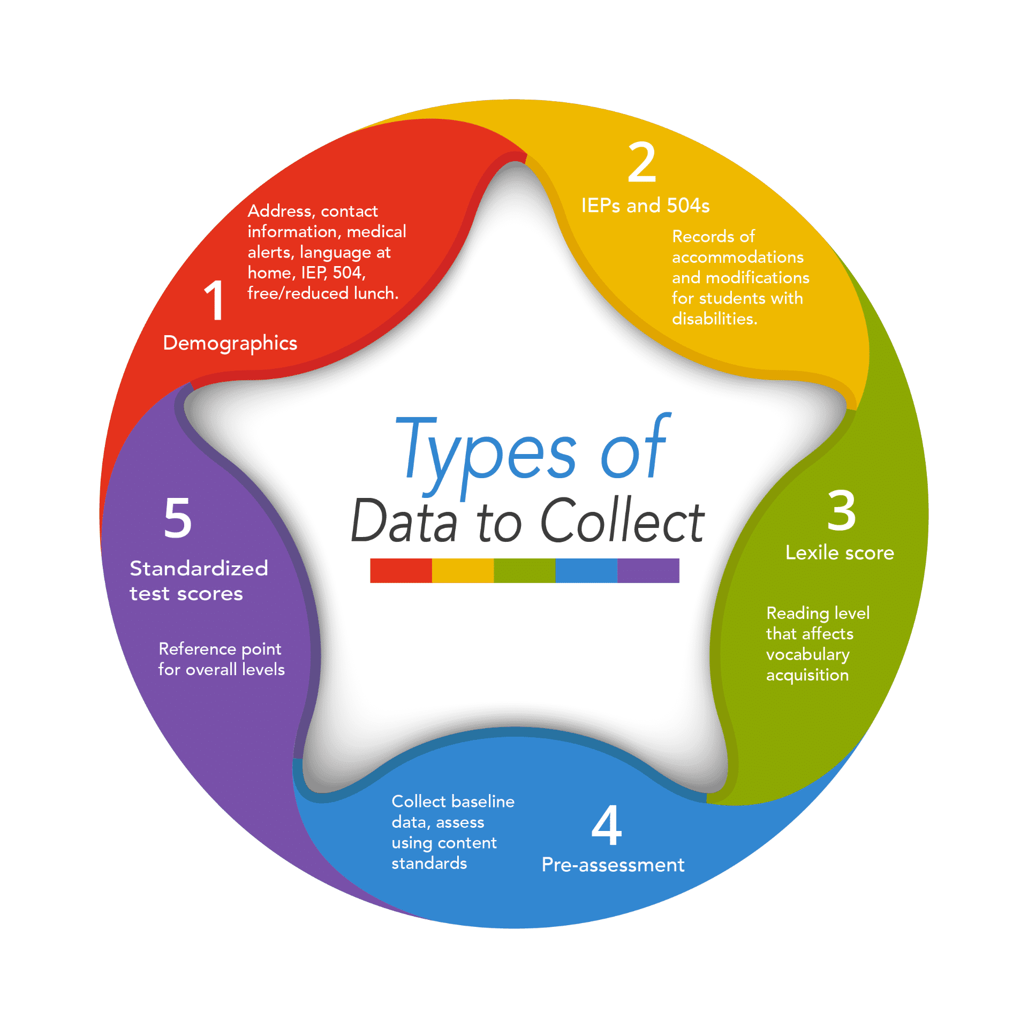
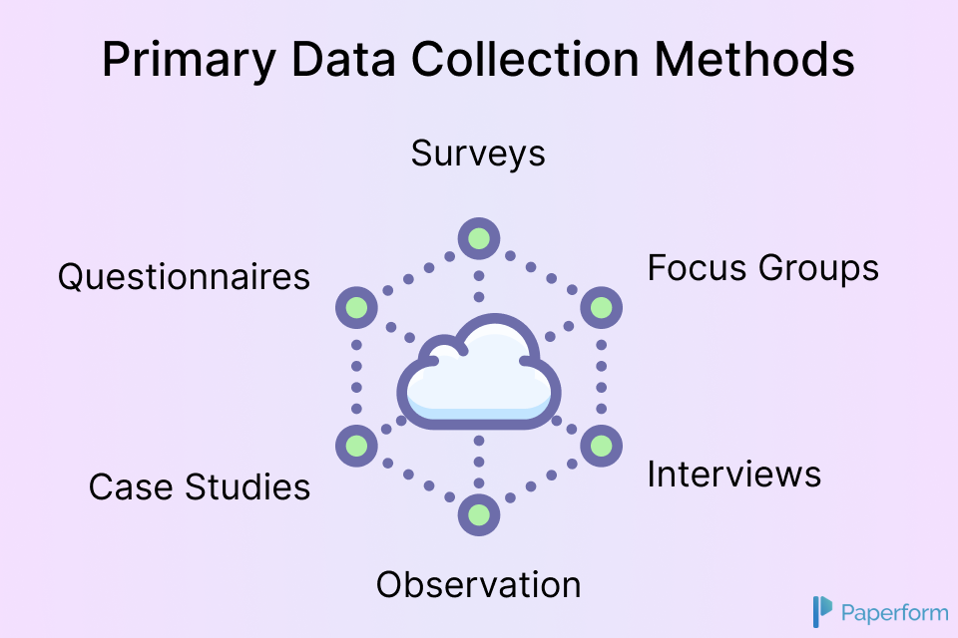
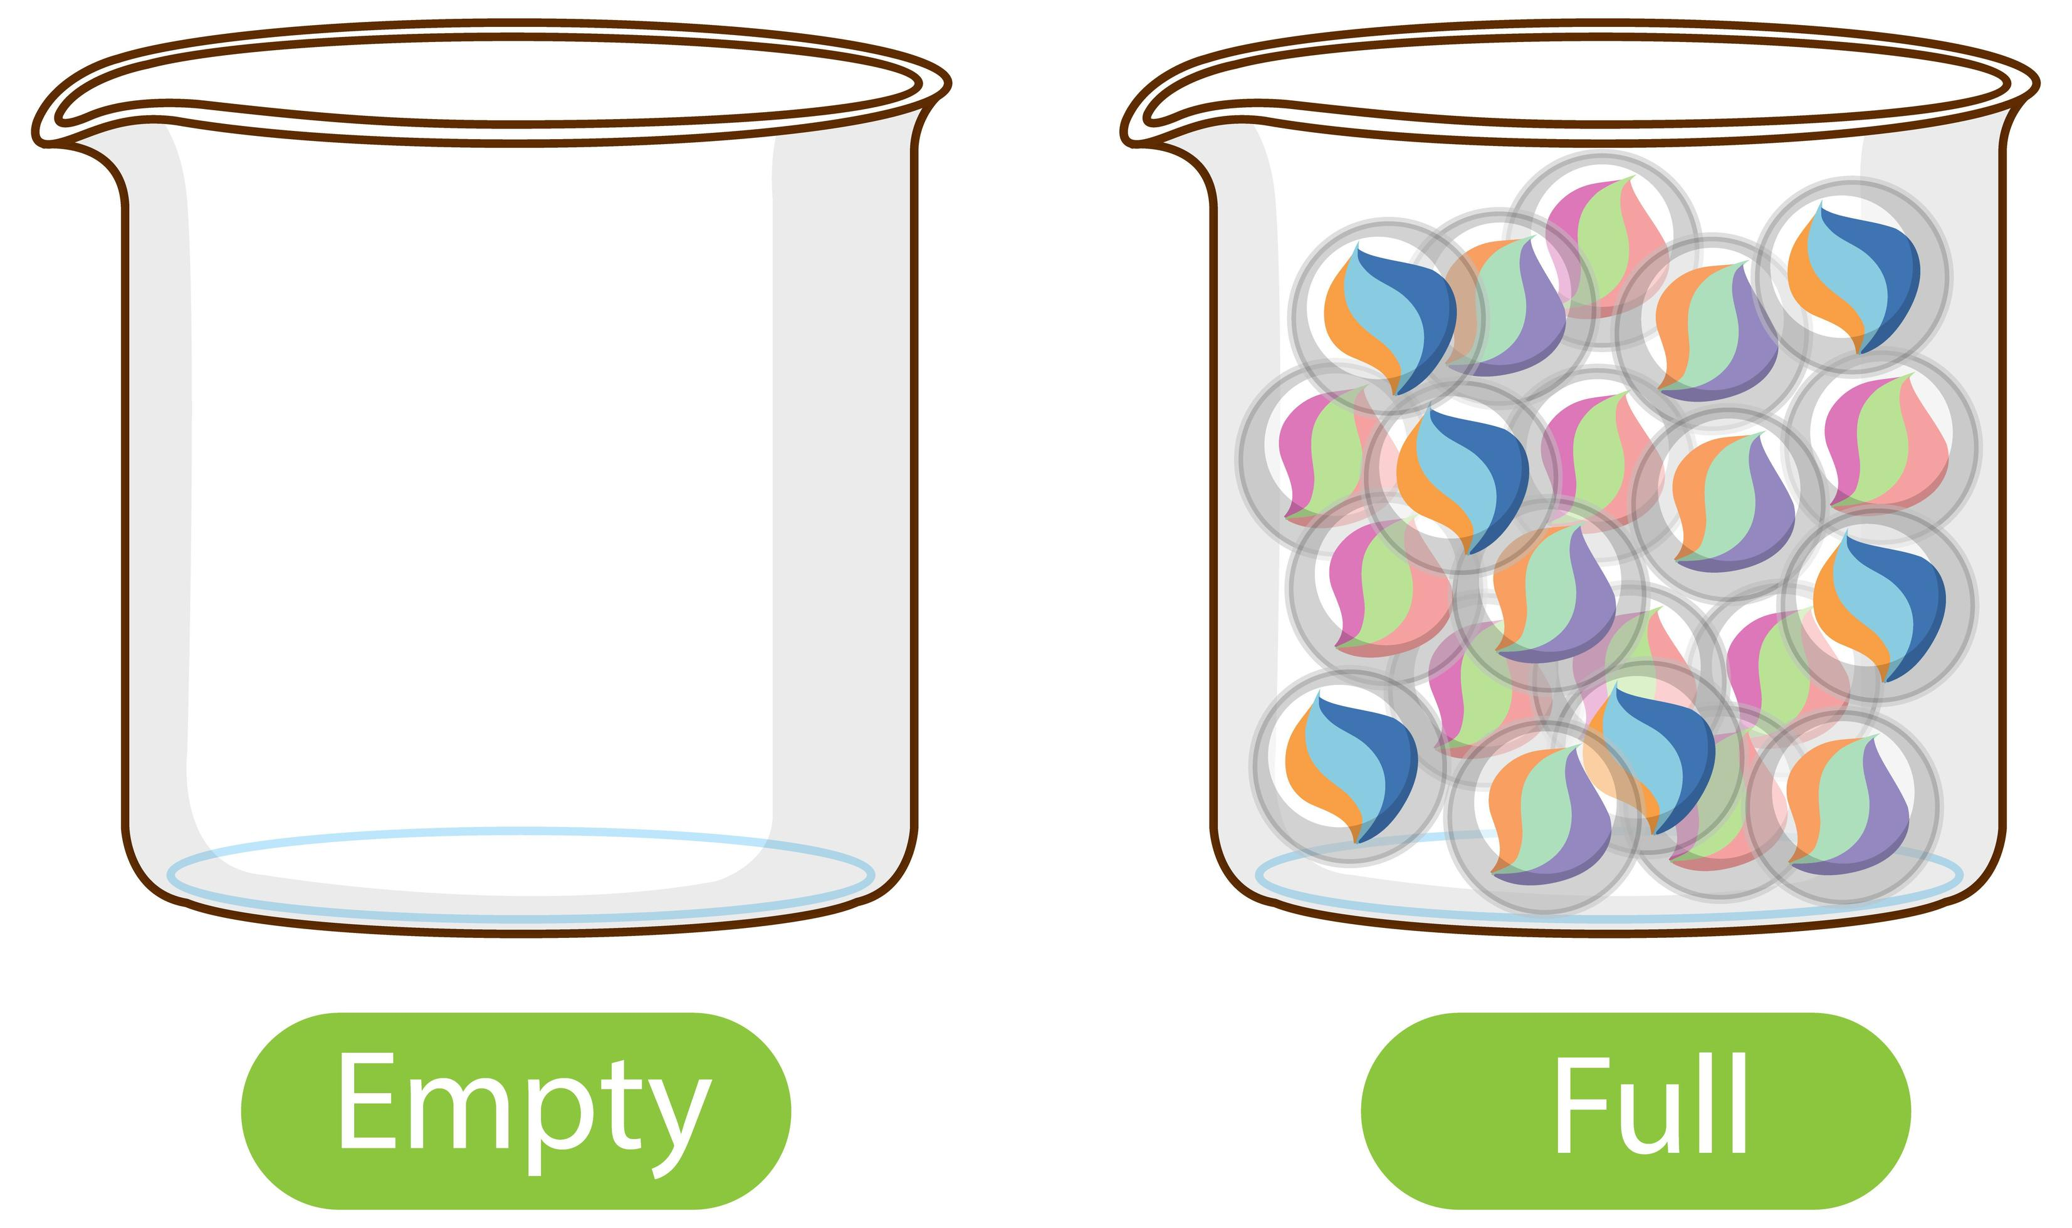
2. Collecting the data
Data: Information (facts, numbers, images) that can be processed
DATA AVAILABILITY
Notes:
What is the topic or problem?
What do you want to know?
What are you wanting to prove?
What are you wanting to disprove?

Slide 17
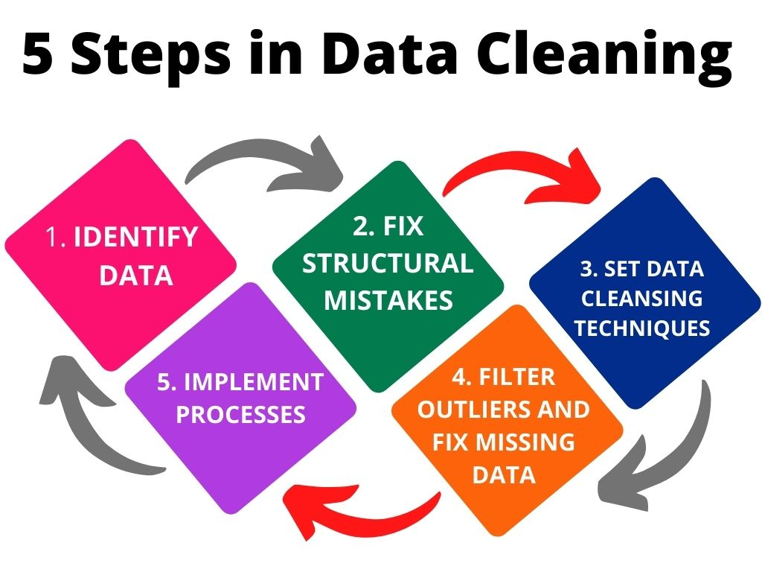
3. CLEANING THE DATA
Importance
Improves reliability of results
Improves productivity
Organized
Avoids unnecessary costs
Improved mapping

Slide 18
4. Analyze the data
WHAT DO WE DO WITH THE DATA?
Analysis:
The act of looking for trends or patterns in data sets
AND
asking questions.
Compile: Receive all data in ready to use form, disaggregate data as necessary
Sort: Group data accordingly: Academic achievement, School Safety, Climate, Parent Involvement, etc.
Report: Provide clear and concise narrative information, easy-to-understand charts and graphs, identify trends and possible red flags
Analyze: Most labor-intensive step and most important! The team should be agreed before drawing conclusions or writing the plan.
GUIDING QUESTIONS FOR DATA ANALYSIS
A) What are the gaps identified by the planning team between the current state of the school and the desired level of performance/vision for reform?
B) How does the planning team suggest that the data be shared with students, parents, teachers, and the community at large?
C) What additional sources of data does the planning team recommend to be collected to inform the evaluation of the planned services? Who will be responsible and how will they be collected?

Slide 19
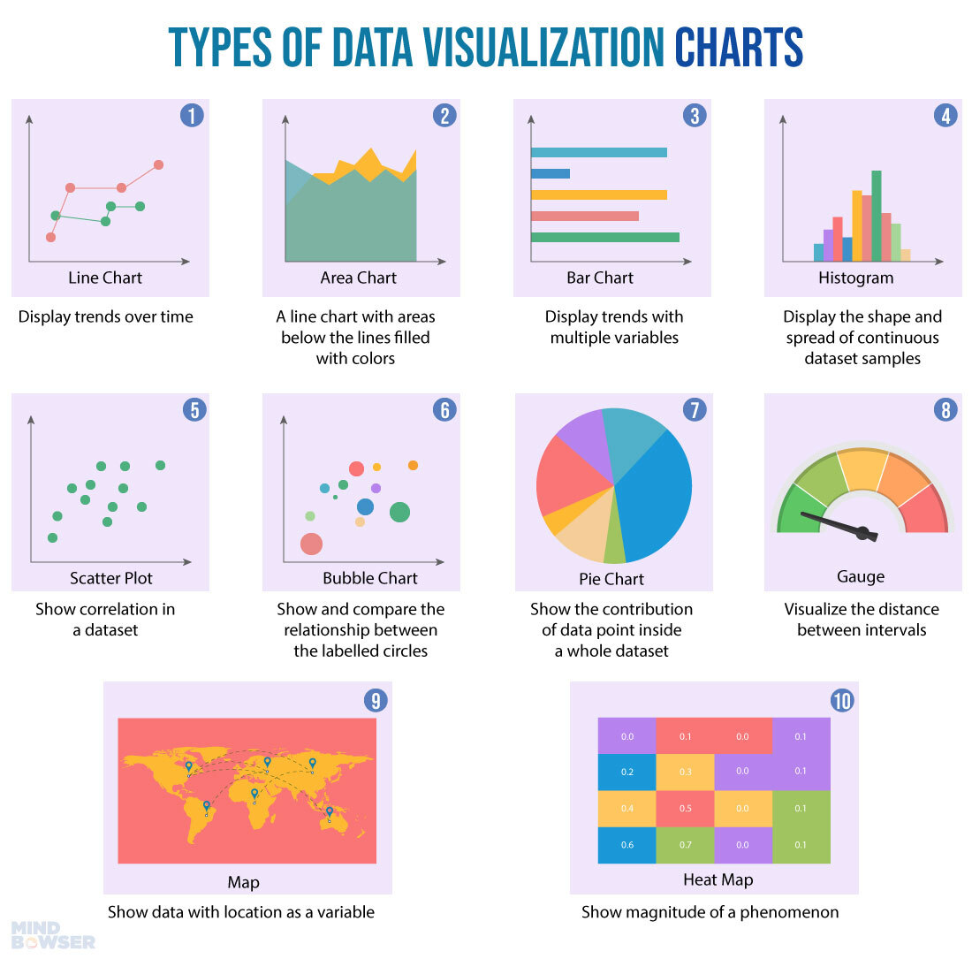
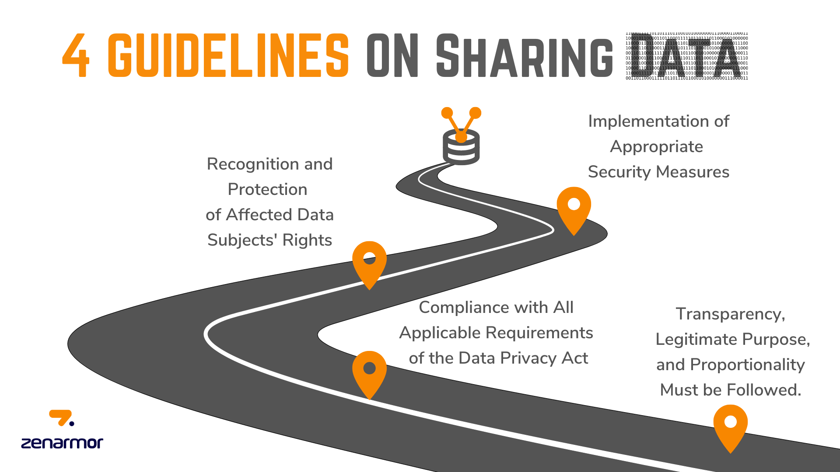
5. Visualize and share findings
Shared Data:
Enhances Understanding of Topic
Is Informative
Can be Actionable
Can Reflect Voice

Slide 20
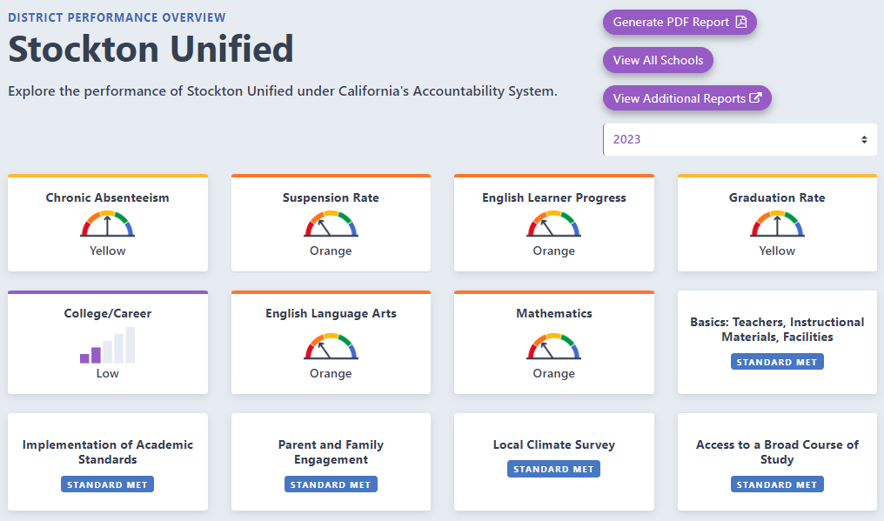
District areas of need – state measures

Slide 21
What is the California Schools Dashboard
The California School Dashboard (Dashboard) is an online tool designed to help communities across the state access important information about kindergarten through grade twelve schools and districts. The Dashboard features easy-to-read reports on multiple measures of school success.
6 State Indicators | 7 Local Indicators
Academic Performance Chronic Absenteeism College/Career Readiness English Learner Progress High School Graduation Rate Suspension Rate | Basic Conditions Implementation of Academic Standards School Climate Surveys Parent Involvement and Family Engagement Access to Courses
Source: https://www.cde.ca.gov/ta/aC/cm/documents/gettingknowdashboard23.pdf

Slide 22
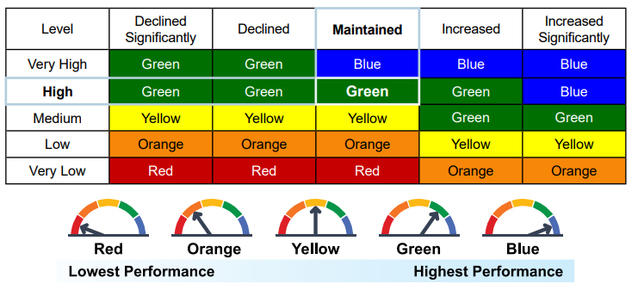
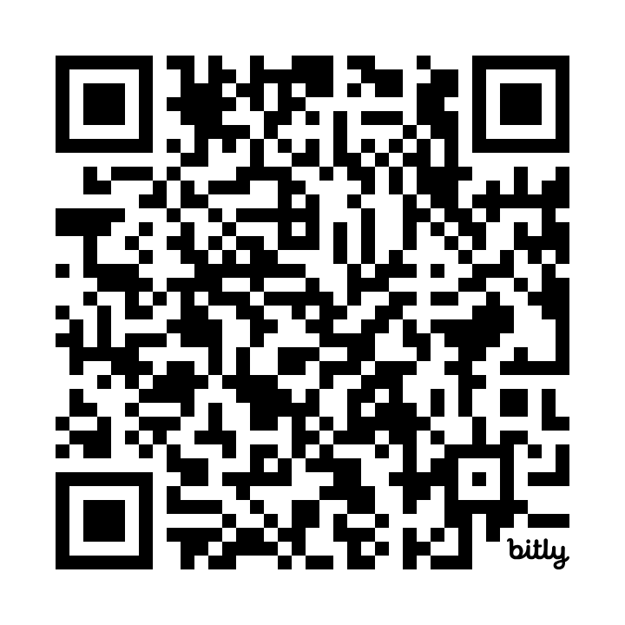
How is performance on the ca dashboard?
Performance is based on two factors:
• STATUS Current year data for the measure
• GROWTH Difference between current year and prior year data
SUSD Ca Schools Dashboard Resources
Resources for
Staff
Parents
Community
Five-by-Five Colored Tables - California School Dashboard and System of Support (CA Dept of Education)
Notes:
How Colors are Determined - CA School Dashboard (CA Dept of Education)
Five-by-Five Colored Tables - California School Dashboard and System of Support (CA Dept of Education)

Slide 23
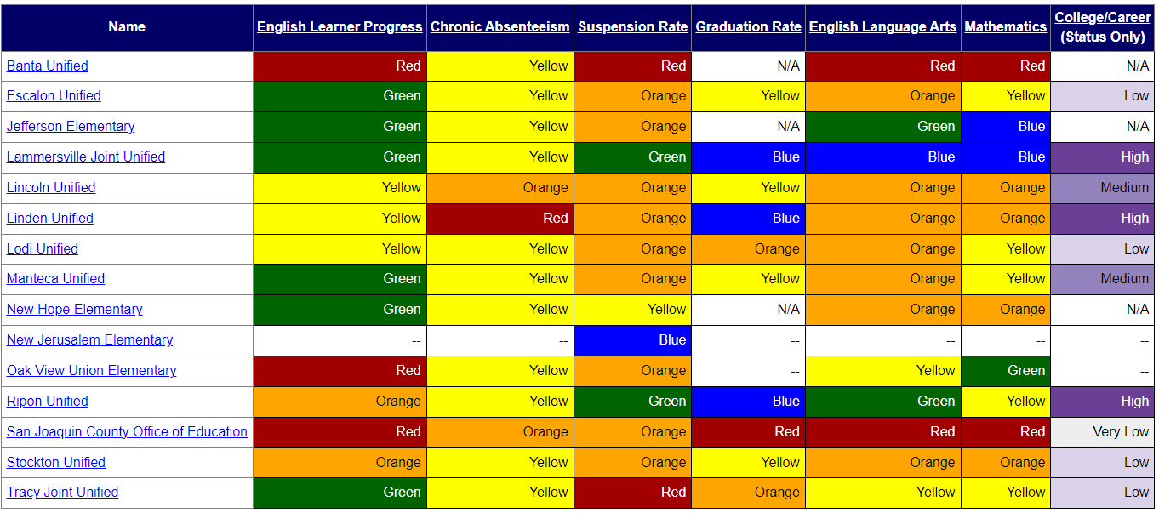
District performance by county 2023
What patterns do you see or notice?
What questions are raised by what you see?
What additional information would you like?

Slide 24
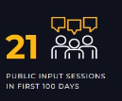
district areas of need – LOCAL MEASURES
“ALL OF SUSD”
Dashboard
www.allofsusd.net

Slide 25
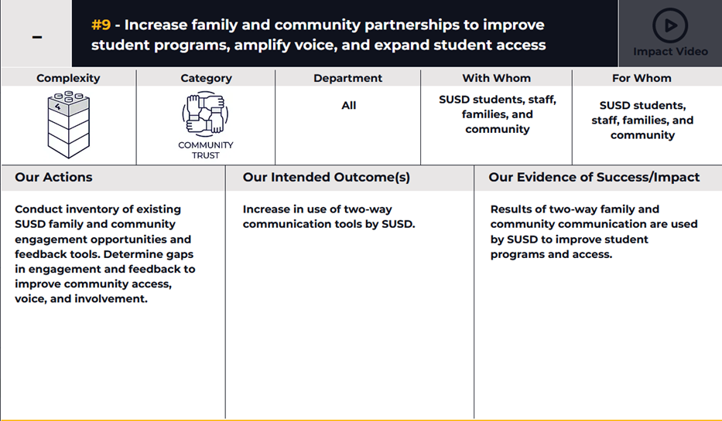
Addressing district AREAS of NEED
Department Scorecard: Staff has developed a department goal to improve and increase connections with educational partners.
Engagement Plan: Staff is developing an engagement plan to guide activities.
Outreach: Staff has developed signage, a brochure, a LCAP logo, and has maintained the webpage to extend communication and engagement opportunities.
YOU + ME = WE
WE MAKE A DIFFERENCE

Slide 26
Next lcap engagement session
FOCUSED TOPIC:
Budget Projections
DATE:
February 16, 2024
TIME:
9:00 a.m. – 10:30 a.m. – Zoom (https://us06web.zoom.us/j/88016804412)
5:30 p.m. – 7:00 p.m. – In Person @ Weber Institute

Slide 27
LCAP Engagement in 2023-2024
11/28: Introduction: LCAP Fundamentals
12/04: Current District Priorities – 2023-2024 School Year
01/19: LCAP Mid-Year Update and Funding
02/09: Data Analysis / District Areas of Need
02/16: Budget Projections
03/05: Survey Results and Key Findings
03/08: Identified District Goals/Activities
* April 2024: Post Draft 2024-2027 LCAP
* May 2024: Public Hearing 2024-2027 LCAP
* June 2024: Board Adoption 2024-2027 LCAP

Slide 28
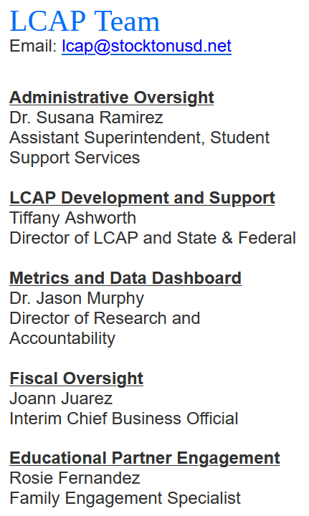
THANK YOU!

